Slide 1
ADA512
Cyber-physical systems & IoT
Lab 1 – Measure
Temperature measurement and object identification
Autumn 2026, Bergen & Førde

Slide 2
Learning outcome
On completion of the exercise the student:
understands the measuring chain:
  the NTC thermistor, the voltage divider and analogue-to-digital conversion as parts of a single chain,
  resolution, accuracy and noise as three distinct properties of that chain,
  relative calibration and the limited range of conclusions that it supports;
understands and applies object identification:
  a first-order thermal object described by K_{P}, T_{P} and L,
  the energy balance as the link between geometry and dynamics,
  the sequence of calculation, comparison, correction of assumed coefficients, second comparison and verification,
  how to reduce the difference between calculation and measurement;
develops and analyses embedded software:
  a fixed-period loop and the timing error it introduces,
  averaging versus filtering, and the difference between them in the context of data acquisition.
ADA512, Autumn 2026
2

Slide 3
Aim
The aim of the lab is to program and identify a thermal object, and then to establish the range in which its first-order model remains valid.
The work proceeds in a fixed order:
  1. the parameters of the model are derived from geometry and material data,
  2. the experiment is carried out,
  3. the coefficients that were initially assumed are computed from the measurement,
  4. the corrected model is checked against a part of the record that did not enter the correction.
The report must follow this order: first the calculation of the parameters, then the comparison and correction, and finally the result together with the range of validity.
ADA512, Autumn 2026
3

Slide 4
Equipment
Issued to each group
  the station: an aluminium profile with the heating resistor, the fan and three NTC sensors,
  the control board, carrying the power stages and all the terminals,
  Arduino UNO R4 WiFi,
  a USB-C cable,
  a 12 V plug-in power supply.
The fan belongs to the set but is not used in this lab; it is needed in Lab 2.
Required, not issued
  a computer with the Arduino IDE installed,
  a program that captures the serial stream: the serial monitor of the IDE, SerialPlot (available free of charge), or a custom script.
No separate measuring instrument is required. Every quantity either comes from the station data table or is measured directly on the station.
The set is signed out and may be taken outside the laboratory. Working conditions: no draught, and the profile must not be in contact with any other object.
ADA512, Autumn 2026
4

Slide 5
Safety
The station operates at low voltage only. Power is supplied as 12 V from a plug-in supply and 5 V from the USB port. No element is at mains potential.
The station limits its own temperature. At full heating power the profile stabilises below 50 °C. A program that stops with the heater on therefore cannot cause overheating, and no thermal cut-out is fitted.
The body of the heating resistor reaches a higher temperature than the profile. It must not be touched while the supply is connected, and no flammable material may rest against it.
Disconnecting the USB cable does not de-energise the heater circuit. The 12 V remains across the terminals of the resistor regardless of the USB port; removing USB only stops the transistor from being driven. Safe rewiring requires the 12 V supply to be unplugged.
A set with damaged insulation, a loose heating resistor or a connector that becomes warm may not be used. It must be reported and exchanged.
ADA512, Autumn 2026
5

Slide 6
The station – data given
Item | Value
profile | aluminium, square tube, 10 x 10 mm outer, length 150 mm
wall and cavity | wall 1.50 mm; cavity 7 x 7 mm, open at both ends
mass | 20.66 g bare profile; 27 g with five M3 x 20 screws and nuts. The difference between them is the steel of the fittings
density, specific heat | aluminium 2.70 g/cm3, 897 J/(kg K); steel 7.85 g/cm3, 460 J/(kg K)
thermal conductivity | aluminium 205 W/(m K)
heating resistor | Bourns PWR220T-20-75R0F, 75 Ω, 1 %, 20 W, at 0 mm
heater supply | 12 V, switched from pin D3, full power only
sensors | 3 x Vishay NTCALUG02A, 10 kΩ, B = 3984 K, at 40, 80 and 120 mm from the heater
divider | 5 V - 10 kΩ 1 % - input - NTC - ground
inputs | A0, A1, A2; up to 14 bits; one reading takes at most 2 µs
maximum temperature | below 50 °C at full power
The heat transfer coefficient h is not given. It must be taken from a plausible range and declared in the report together with its source.
ADA512, Autumn 2026
6

Slide 7
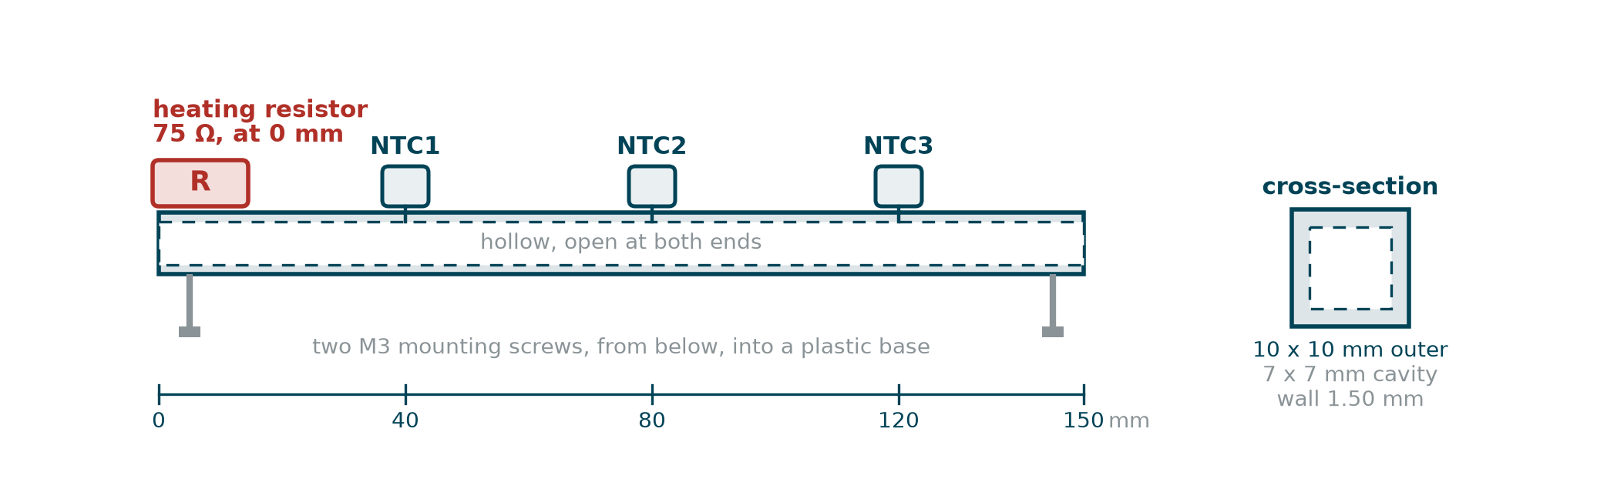
The station – construction
The heating resistor is mounted at one end of the profile. The three temperature sensors are bolted to the profile at 40, 80 and 120 mm from the heater. The profile rests on two screws and touches nothing else.
ADA512, Autumn 2026
7

Slide 8
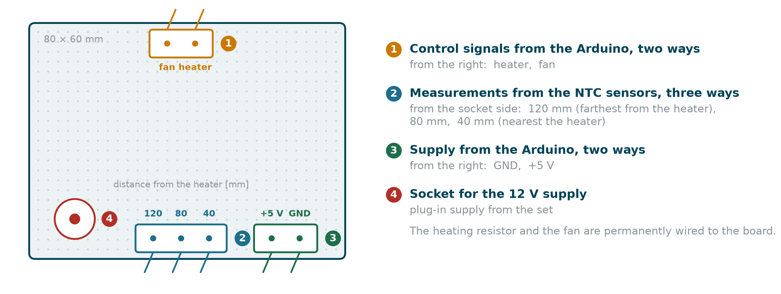
The control board – terminals
The control board carries the power stages and every terminal of the set. The heating resistor and the fan are permanently wired to it. The three detachable terminal blocks all lead to the Arduino, and the 12 V supply enters through the socket.
The measurement ways follow the profile itself: counted from the side of the 12 V socket they carry the sensors at 120, 80 and 40 mm from the heater.
ADA512, Autumn 2026
8

Slide 9
Documentation
The following documentation sources are required for this lab:
Arduino UNO R4 WiFi – product page, pinout and datasheet; the functions analogReadResolution, analogRead, digitalWrite, millis, micros. These are used to configure the analogue inputs, control the power stage and measure time in the acquisition loop.
Bourns PWR220T-20 – datasheet, including the thermal derating curve. This information is used to determine the permissible power dissipation of the heater resistor.
NTC thermistor – datasheet and the equation with the B parameter. This equation is used to convert the measured resistance into temperature.
ADA512, Autumn 2026
9

Slide 10
Documentation – lectures
Lecture 2 – the FOPDT model: K_{P}, T_{P} and L, and how each is read from a step response. The delay L is counted from the moment the curve starts to move; this rule is applied directly in Task 6.
Lecture 3 – measuring chain, uncertainty and calibration. The numerical example there is computed for a solid bar. The profile on the station is a tube, so the loss coefficient must be derived from the geometry of the actual object.
Lecture 4 – sampling, aliasing and the averaging window. These concepts enter the justification of the sampling period chosen in Task 5.
ADA512, Autumn 2026
10

Slide 11
Two kinds of number in the model – measured and assumed
The model of the object contains four coefficients:
  heat capacity C,
  heat exchange area A,
  heat transfer coefficient h,
  heater power P.
The coefficients C and A are obtained from weighing and from geometric measurements of the profile, and are therefore treated as measured. By contrast, h and P are initially taken from stated literature or catalogue ranges and are therefore treated as assumed.
ADA512, Autumn 2026
11

Slide 12
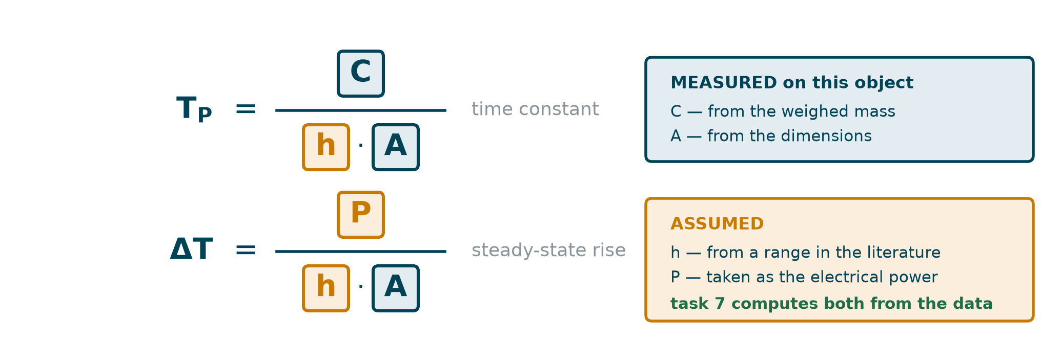
Which coefficients may be computed from data
This distinction decides which coefficients may be changed and computed from data in Task 7: the measured coefficients C and A remain fixed, while the assumed coefficients h and P may be identified from the recorded response.
As a consequence, almost all of the uncertainty of the calculations is carried by h and P. A typical difference between model prediction and measurement will therefore be of the same order as the uncertainty in these two coefficients.
ADA512, Autumn 2026
12

Slide 13
A model that omitted friction
The centrifugal governor of 1788 controlled steam engines for decades before any theory described it. Maxwell published the first analysis in 1868, eighty years after the device had entered service.
During the nineteenth century the workmanship of machines improved and friction in their linkages decreased. Governors then began to oscillate instead of settling at the set speed.
Friction, which no calculation contained and which was seen as a defect of manufacture, acted as damping. Removing it removed the damping as well. The remedy was to add damping deliberately: later governors were built with oil dashpots.
An object contains effects that the model omits. Some are negligible. Some are beneficial. The absence of an effect from the model does not mean it is absent from the object.
ADA512, Autumn 2026
13

Slide 14
How far a first model can miss
Domain | First model agrees to | Quantity carrying the uncertainty
RC or RL circuit | 1 - 3 % | none; R and C are measured directly
electric drive | 5 - 10 % | friction, moment of inertia
thermal object in air | 20 - 50 % | heat transfer coefficient
flow in a pipe | 10 - 30 % | roughness, local losses
mechanical contact | 50 - 200 % | surface condition
Experience from electrical circuits does not carry over directly to thermal objects. In this exercise an initial difference of several tens of percent between model and measurement is the expected result, not a sign of failure.
ADA512, Autumn 2026
14

Slide 15
How far a first model can miss – the loss coefficient
The assumed parameters are then recomputed using the model. The electrical power supplied to the circuit does not turn entirely into heat in the profile, and free convection is given in the literature as roughly 5–10 W/(m²K).
The loss coefficient from Lecture 3, written UA, is the product of these two quantities: UA = h · A
Splitting it into two factors is what allows a decision about the inner surface: changing A while leaving h unchanged.
ADA512, Autumn 2026
15

Slide 16
What this model leaves out
The lumped first-order model describes the profile with three numbers. The real object contains at least six effects that the model does not cover:
  the inner surface of the hollow profile,
  the thermal resistance of the joint under the heating resistor,
  the mounting screws acting as fins,
  the sensor leads acting as fins,
  the distribution of temperature along the profile,
  the time heat needs to travel along the profile.
The first four change the numerical values of the coefficients in the lumped model. The last two mean that the object is not exactly of first order: it does not behave as if the entire profile had a single uniform temperature.
ADA512, Autumn 2026
16

Slide 17
The work is a loop, not a line
The assumed coefficients are corrected once, in Tasks 2 and 3, and the correction is then checked in Task 4 on new data.
Computing coefficients from data is called identification. Changing numbers until a curve looks right is called curve fitting. Task 7 sets out the difference between these two approaches.
ADA512, Autumn 2026
17

Slide 18
Order of work
Calibration requires a stable profile temperature, preferably room temperature, with no heating. For that reason:
  1. the station should be allowed to cool to ambient before calibration, and
  2. calibration should be carried out before the first heating run whenever possible.
ADA512, Autumn 2026
18

Slide 19
Task 1 – Commissioning
Item | p
a) the set checked against the list; the sensor at 40, at 80 and at 120 mm established | 1
b) the wiring checked by the touch test on three channels | 1
total | 2
The purpose of Task 1 is to check the basic health of the station and the wiring of the sensors.
The touch test consists of warming one sensor with a finger and observing the three readings. Correct wiring shows as a change in exactly one reading. If two readings change, the wires are crossed; a station in that state is not fit for calibration and must be reported.
The components are soldered and are not to be disconnected, so the touch test is the only practical check of the connections.
ADA512, Autumn 2026
19

Slide 20
Task 2 – Parameters derived from theory
Item | p
a) the complete calculation: heating power, heat capacity, exchange area, loss coefficient, steady-state rise, T_{P} and K_{P} | 4
b) decision on the inner surface, explicit and justified | 2
c) decision on the mass, explicit and justified | 1
d) agreement threshold, declared with its justification | 1
total | 8
Task 2 is carried out before any measurement and before the program is written. In this task, the theoretical parameters of the model are derived from geometry and material data.
ADA512, Autumn 2026
20

Slide 21
Task 2 – Heat capacity, the two decisions and the threshold
The heat capacity of a body made of several materials is the sum of the contributions of its parts: C = Σ mᵢ · cᵢ
Each part contributes its own mass mᵢ multiplied by the specific heat cᵢ of its material. The heat capacity C of the profile must be computed on this basis and the values used must be documented.
(b) Inner surface. The profile is hollow and open at both ends, so it has an inner surface as well as an outer one. It must be decided whether the inner surface is included as part of the exchange area A. The decision and its justification must be recorded in the report.
ADA512, Autumn 2026
21

Slide 22
Task 2 – The mass, the threshold and the outcome
(c) Mass. Two masses are given: one for the profile alone and one for the profile with steel fittings. The difference between them is the mass of the steel fittings. It must be decided which mass is used in the model, and this choice must be justified.
(d) Agreement threshold. A single number must be written down before the measurement: by how many percent the two independent determinations of the power in Task 7 may differ and still count as agreeing. A threshold declared after seeing the result does not serve this purpose and is not acceptable.
The outcome of Task 2 is a short design note containing the computed heat capacity C, the decisions on inner surface and mass, and the declared agreement threshold.
ADA512, Autumn 2026
22

Slide 23
Task 3 – Program: acquisition and calibration
Item | p
a) fixed-period loop, independent of execution time | 1
b) period error measured and recorded | 1
c) converter reading converted to resistance, three channels | 1
d) averaging, with the number of samples justified | 1
e) three correction factors and the channel spread before and after calibration | 2
f) the two questions on the form of the correction | 1
g) calibration checked on data other than the calibration set | 1
total | 8
In Task 3 a data-acquisition program is written and used to determine calibration factors for the three sensors.
ADA512, Autumn 2026
23

Slide 24
Task 3 – The fixed-period loop and the clock
(a) Time sources. The Arduino library offers millis() and micros() as time sources; their resolution is stated in the documentation of the board. The function delay() does not produce a fixed period, because the delay is added to the execution time of the loop. This yields a loop whose period equals the execution time of the program plus the delay, which is not constant.
(b) Period error. In every cycle the program reads the clock, computes the interval since the previous cycle, and records its departure from the intended period T_{s}:
  t_{k} – clock reading at the start of cycle k,
  Δ_{k} = ( t_{k} − t_{k−1} ) − T_{s}.
In this way the program measures how far each cycle runs late or early. The sequence Δ_{k} must be recorded together with the data.
ADA512, Autumn 2026
24

Slide 25
Task 3 – Averaging and calibration conditions
(d) Averaging. One ADC reading takes approximately 2 µs, so a hundred samples per channel cost less than a millisecond and time is not the limiting factor. Above some number of samples the mean stops improving, because what remains is no longer random noise. An appropriate averaging length must be chosen and justified.
(e) Conditions for calibration. The correction factors are determined under controlled conditions:
  heater off for at least 30 minutes,
  no channel changing by more than 0.02 K over two minutes,
  the profile lying free, with no draught.
These conditions must be documented and respected when collecting the calibration data set.
ADA512, Autumn 2026
25

Slide 26
Task 3 – Questions and the calibration check
(f) Questions to be answered in the report:
  Why does the correction multiply the resistance, instead of subtracting kelvins from the temperature?
  Why is the correction applied before the conversion to temperature rather than after it?
(g) Checking the calibration. The correction factors are determined so that the three channels agree on the calibration data set. Reprocessing that same set and finding agreement follows from the definition of the factors, not from any property of the sensors.
The real check is to apply the factors to an independently collected data set: a second rest recording, or a recording made after the profile has cooled at the end of Task 5. The report must show this check and comment on the result.
ADA512, Autumn 2026
26

Slide 27
Task 4 – Program: temperature and logging
Item | p
a) resistance converted to temperature | 1
b) open and shorted input recognised | 1
c) complete log record | 1
total | 3
In Task 4 the program is extended to convert resistances into temperatures and to log the results to a file.
(b) Invalid readings. A reading corresponding to an open or shorted input indicates a broken connection, not a temperature. The program must recognise such readings and mark them as invalid, instead of converting them to a numeric temperature.
ADA512, Autumn 2026
27

Slide 28
Task 4 – The log record
The ADC of the Arduino UNO R4 works at 10 bits by default; 14-bit resolution requires an explicit call to analogReadResolution(14). A program written for 14 bits will also start without that call, but with a coarser resolution.
(c) Log record format. Each log record must contain:
  a time stamp,
  the period error Δ_{k} from Task 3(b),
  three resistances,
  three temperatures.
The tool and file format are free, provided the data can be opened and processed independently.
ADA512, Autumn 2026
28

Slide 29
Task 5 – Preliminary run and step response
Item | p
a) preliminary run recorded; initial slope of each channel read | 1
b) power entering the profile computed from the slope and compared with the electrical power | 1
c) rest segment of at least two minutes and a run carried through to steady state | 1
d) numerical criterion for steady state | 1
e) sampling period justified against both bounds, with the tighter one named and the number of records given | 2
total | 6
Task 5 serves two purposes: to obtain an estimate of the heater power actually entering the profile in the preliminary run, and to record the step response needed for identification in the long run.
ADA512, Autumn 2026
29

Slide 30
Task 5 – Steady state criterion
(d) Steady state. Steady state is recognised by a numerical criterion stated in the report, for instance by comparing the increase over a given time window with the noise of the measuring chain. Visual inspection of the curve is not a sufficient criterion.
ADA512, Autumn 2026
30

Slide 31
Task 5 – The preliminary run
Immediately after the heater is switched on, the profile is still at ambient temperature and loses essentially no heat to the air. The whole of the power raises its temperature, and the energy balance reduces to C · dT/dt = P
At the start the rate of rise therefore depends only on the power P and on the heat capacity C. The heat transfer coefficient h does not appear at all, because the losses have not yet begun.
Procedure:
  apply full power for about five minutes;
  for each channel, determine the slope over the first 30 seconds, counted from the instant that channel begins to respond;
  average the three slopes and multiply by the heat capacity: P = C · mean initial slope
The length of the 30-second interval matters. Over this time the losses have barely begun, so the method underestimates the power by a few percent; the agreement threshold from Task 2 must allow for that.
ADA512, Autumn 2026
31

Slide 32
Task 5 – What the preliminary run establishes
The upper limit of the power entering the profile is the electrical power, computed from the supply voltage and the resistor’s resistance. The value obtained from the initial slope is lower.
How much lower depends on:
  the thermal resistance of the joint between resistor and profile,
  the tightening of that joint and the presence or absence of heat-conducting compound,
  the area of the resistor body dissipating heat directly to the air,
  the heat carried away by leads and screws.
The difference may be small or may approach half the electrical power. It cannot be calculated in advance, which is precisely why it is measured. This is the first coefficient obtained from measurement rather than from assumption. It is obtained before the long run begins and returns in Task 7 as one half of the verification.
ADA512, Autumn 2026
32

Slide 33
Task 5 – The sampling period
The sampling period is bounded both from above and from below, and each bound requires its own justification.
Upper bound. Too long a period removes short-lived features from the record. The shortest time quantity measured here is the delay L at the sensor nearest the heater, not the time constant, and it is L that sets this upper bound.
Lower bound. With too short a period consecutive samples differ by less than the noise of the measuring chain, so additional samples carry no new information while the number of records grows to a size that is awkward to process.
The report must state the sampling period used, which of the two bounds proved tighter, and the number of records obtained in the long run. The time constant of the object is expressed in minutes; the recording runs longer than a teaching block and is intended to run unattended.
ADA512, Autumn 2026
33

Slide 34
Task 6 – Data processing
Item | p
a) K_{P}, T_{P} and L for each of the three channels | 3
b) plot with the construction of the time-constant reading marked | 1
c) three steady-state temperatures and the difference between the outer channels | 1
total | 5
In Task 6 the recorded data are processed to obtain the parameters K_{P}, T_{P} and L.
(a) Reading the time constant. If T_{P} is read from the instant the heater is switched on, the delay L enters the result as well, and L differs from sensor to sensor. The three channels then give three different time constants although the profile has only one. Therefore the reading of T_{P} must start from the instant at which the sensor concerned begins to respond.
ADA512, Autumn 2026
34

Slide 35
Task 6 – What the drawings must show
Drawings in the report must carry information; they are not mere illustrations. The report must include at least:
The step-response plot:
  all three channels on one time axis,
  the construction used to read the time constant, marked on the curve,
  the delay L marked for each channel,
  the three steady-state levels and the difference between the outer channels.
The sketch of the profile: with a clear indication of which surfaces were counted as the exchange area in Task 2.
ADA512, Autumn 2026
35

Slide 36
Task 7 – Comparison, identification and verification
Item | p
a) table of predicted against measured values, with the relative difference of each | 1
b) which quantities agree and which do not, and the inconsistent coefficient named | 1
c) h and the power computed from the measurement | 2
d) both results checked against ranges established beforehand | 1
e) the two determinations of the power compared, with the threshold of Task 2 applied | 2
f) what remains, and why a change of coefficients cannot remove it | 1
total | 8
In Task 7 the theoretical model is compared with the measurements, the coefficients h and P are identified, and the model is verified.
ADA512, Autumn 2026
36

Slide 37
Task 7 – Identifying the inconsistent coefficient
Agrees | Disagrees | Inconsistent coefficient
time constant | rise and gain | power
rise and gain | time constant | heat capacity
neither | both, in the same direction | area or h
Both key formulas share the same denominator h·A but have different numerators: T_{P} = C / ( h·A ) and ΔT = P / ( h·A ). The power P does not occur in the formula for the time constant.
From this relation the table of cases above is constructed. The report must state which row applies and on what evidence. The delay L and the three different steady-state rises appear in no row, because they belong to the structure of the model, not to its coefficients.
ADA512, Autumn 2026
37

Slide 38
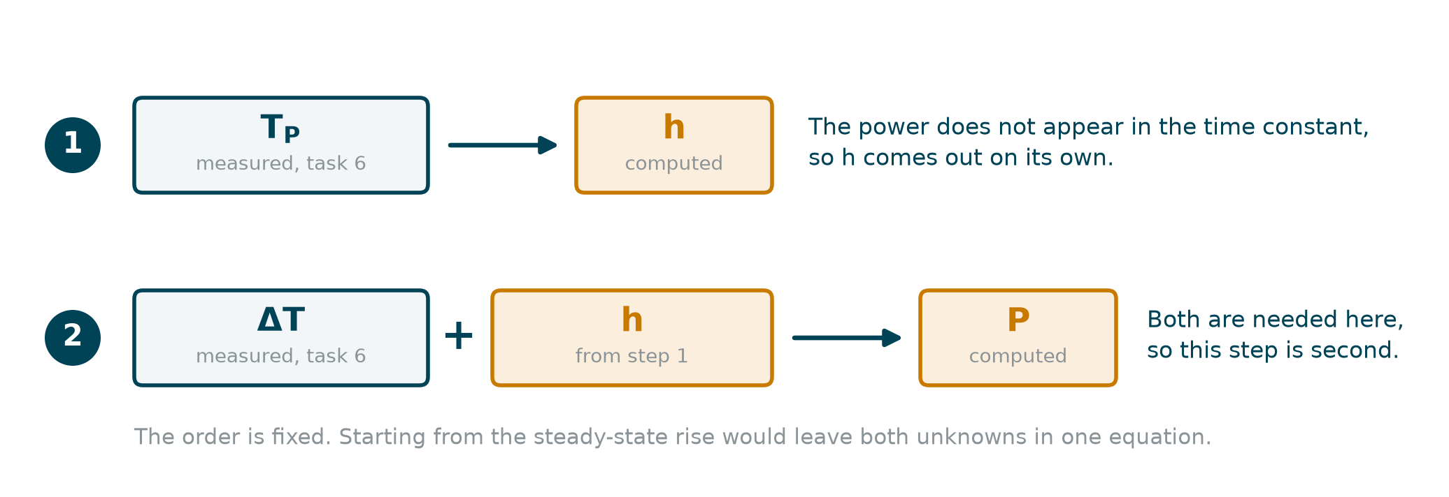
Task 7 – Computing h and the power
The identification proceeds as follows: h = C / ( T_{P} · A ), then P = ΔT · h · A.
Only the coefficients that were assumed, here h and P, may be computed from the data; those that were measured, C and A, remain unchanged.
ADA512, Autumn 2026
38

Slide 39
Task 7 – Why only two coefficients
Two independent measured quantities allow exactly two coefficients to be determined.
If the heat capacity C were also allowed to change, then for every value of h there would exist a heat capacity and a power that reproduce the data exactly. Among those solutions is one in which the heater loses no power at all and the mass of the profile is one third larger than the weighed value. Only the weighing rules such solutions out.
Changing numbers until a curve fits is curve fitting. Computing coefficients that were declared unknown beforehand, and then checking them against independent limits, is identification.
ADA512, Autumn 2026
39

Slide 40
Task 7 – Verification
(d) Admissible ranges. Each computed coefficient must fall inside a range established before the calculation and taken from a source other than the measurement itself: h inside the range for free convection together with radiation, and P no greater than the electrical power, since energy is not created. A coefficient outside its range means that the fault lies in the structure of the model, and no change of numbers will remove it.
(e) The two determinations of the power. The preliminary run gives the power from the very beginning of the record. Task 7 gives it from the steady-state rise and the time constant, that is from the whole record. For a first-order object the two agree, because for an exponential rise the initial slope equals the rise divided by the time constant.
The agreement threshold declared in Task 2 applies here, after allowing for the few percent by which the slope method underestimates the power. A larger difference means that the record is not a single exponential, and therefore that the object is not of first order.
ADA512, Autumn 2026
40

Slide 41
Task 7 – What remains after identification
Once h and P have been computed, the steady-state rise ΔT and the time constant T_{P} agree between model and measurement. Two discrepancies remain:
  the model gives a delay of zero, while the measurement shows a delay that grows with distance from the heater,
  the model gives one steady-state temperature, while the measurement shows three different ones.
Both follow from the assumption that the whole profile has one uniform temperature. That assumption belongs to the structure of the model, not to its coefficients, and no change of numbers removes it. Removing it requires a model with distributed parameters.
ADA512, Autumn 2026
41

Slide 42
The report
There is one report per group. The document must allow the work to be repeated and the same results to be obtained without reference to any other source.
Order of contents:
  1. group number and all members,
  2. the calculations of Task 2, the declared agreement threshold and the list of assumed coefficients,
  3. design decisions with their justifications,
  4. course of the experiment, with the preliminary run presented first,
  5. results: tables and plots with units,
  6. comparison, identification, verification and range of validity of the model,
  7. attachments: data files and source code.
ADA512, Autumn 2026
42

Slide 43
Assessment
Task | p
1 – commissioning | 2
2 – parameters derived from theory | 8
3 – acquisition and calibration | 8
4 – temperature and logging | 3
5 – preliminary run and step response | 6
6 – data processing | 5
7 – comparison, identification and verification | 8
total | 40
pass mark | 30
The item tables under each task show where the points come from. A point covering several numbers refers to the correctness of the calculation as a whole, not to each individual number separately.
ADA512, Autumn 2026
43

Slide 44
Requirements on the answers
Every item must be completed, every result must carry a unit, every design decision must be justified.
A statement that a result was not obtained, together with the reason, is considered a correct answer. An item left blank is not.
A large difference between prediction and measurement is not an error and does not lower the mark, provided it is explained. An unexplained difference does reduce the mark.
ADA512, Autumn 2026
44

Slide 45
Notes that may save time
Calibration requires a cold station. Carrying it out before the first heating saves about half an hour of waiting.
One reading takes about 2 µs, so a hundred samples per channel take less than a millisecond. Time is not what limits averaging.
Filtering carried out inside the program cannot be undone. Filtering carried out during analysis remains reversible, because the raw data are kept.
Recording resistances alongside temperatures allows the conversion to be repeated with different coefficients without repeating the experiment.
A pin not configured as an output enables only a weak pull-up. The power stage is then intact but the heater does not heat.
ADA512, Autumn 2026
45

Slide 46
Summary – the thermal model
The profile is treated as a first-order thermal object with delay. The energy balance of the lumped model reads C · dT/dt = P − h·A·( T − T_{amb} ), where T_{amb} is the ambient temperature.
Long after the step the derivative vanishes, which leaves the steady-state rise ΔT = P / ( h·A ), that is the difference between the steady-state temperature and the ambient temperature.
From the same balance follow the time constant T_{P} = C / ( h·A ), the static gain K_{P} = ΔT / P = 1 / ( h·A ) and the loss coefficient of lecture 3, UA = h·A.
ADA512, Autumn 2026
46

Slide 47
Summary – measured and assumed coefficients
Two coefficients are measured and stay fixed throughout the identification:
  C, the heat capacity, obtained from the masses and the specific heats, C = Σ m_{i}·c_{i},
  A, the heat exchange area, obtained from the geometry; the decision about the inner surface must be documented.
Two coefficients are assumed at the outset and identified later from the data:
  h, taken from the literature range for free convection together with radiation,
  P, bounded above by the electrical power and estimated from the preliminary run.
In Task 7 only h and P may be changed. C and A keep the values computed in Task 2.
ADA512, Autumn 2026
47

Slide 48
Summary – the preliminary run
Immediately after the heater is switched on the profile is still at ambient temperature, the losses are therefore negligible and the balance reduces to C · dT/dt ≈ P.
The procedure is:
  apply full power for about five minutes,
  for each channel read the slope over the first 30 seconds, counted from the instant that channel begins to respond,
  average the three slopes,
  obtain the power as P ≈ C · mean initial slope.
The losses have already begun, so this estimate is slightly low. The agreement threshold declared in Task 2 must allow for a difference of a few percent.
ADA512, Autumn 2026
48

Slide 49
Summary – reading K_{P}, T_{P} and L
The delay L is the time between the switching on of the heater and the instant at which the sensor concerned begins to respond. In the literature the same quantity is also called dead time.
The time constant T_{P} is measured from that instant and not from the switching on. A reading taken from the switching on carries L in it as well, and yields three different time constants for a profile that has only one.
Each channel therefore supplies from the record the instant t₀ at which the curve begins to rise, the initial level T₀, the steady-state level T_{ss} and the rise ΔT = T_{ss} − T₀.
The time constant is the interval, counted from t₀, in which the curve covers the fraction 1 − 1/e ≈ 0.632 of that rise: T( t₀ + T_{P} ) = T₀ + 0.632·ΔT, the construction used in lecture 2.
Only one time constant enters the model.
ADA512, Autumn 2026
49

Slide 50
Summary – identification of h and the power
The identification uses C and A from Task 2 together with T_{P} and ΔT read from the long run: h = C / ( T_{P} · A ), and then P = ΔT · h·A.
Three checks follow. The value of h must lie inside the range declared for free convection together with radiation. The power P must not exceed the electrical power. The power from the preliminary run and the power obtained here must agree within the threshold of Task 2.
A coefficient lying outside its admissible range means that the fault is in the structure of the model, and no change of numbers will remove it.
ADA512, Autumn 2026
50

Slide 51
Summary – the measuring chain
The chain runs from the NTC thermistor through the voltage divider and the analogue-to-digital converter to the conversion carried out in the program.
Three properties are separate, and each is established by its own procedure:
  resolution – the smallest change of temperature that changes the recorded number,
  accuracy – how far a reading may lie from the true temperature,
  noise – the spread of the readings while the temperature does not change.
None of the three implies another. Relative calibration brings the channels into agreement with one another but not with an absolute standard. It therefore supports statements about the gradient along the profile, about the rise above ambient and about the time constant, but not about the absolute value of the temperature.
ADA512, Autumn 2026
51

Slide 52
Summary – the acquisition loop
T_{s} denotes the nominal sampling period and t_{k} the time stamp taken at the start of cycle k, read with millis() or micros(). The period error of that cycle is Δ_{k} = ( t_{k} − t_{k−1} ) − T_{s}.
The choice of T_{s} is bounded from both sides. From above it must be small compared with the shortest dynamic present in the record, which is the delay L of the sensor nearest the heater and not the time constant. From below, a period so short that consecutive samples differ by less than the noise adds data without adding information, and makes the processing heavier.
The report states the value of T_{s}, which of the two bounds was the tighter one, and how many samples were collected.
ADA512, Autumn 2026
52

Slide 53
Legend – the object
  C – heat capacity of the profile, J/K. The heat required to raise its temperature by one kelvin.
  A – heat exchange area, m². The surface over which the profile exchanges heat with its surroundings.
  h – heat transfer coefficient, W/(m²K). How strongly the profile exchanges heat with the air and by radiation; it depends on the mounting, on the movement of the air and on the surroundings.
  UA – loss coefficient of lecture 3, W/K, equal to h·A.
  P – power entering the profile, W. Not necessarily equal to the electrical power supplied to the heater.
ADA512, Autumn 2026
53

Slide 54
Legend – the model
  ΔT – steady-state rise, K. The difference between the steady-state temperature and the ambient temperature.
  K_{P} – static gain of the thermal object, K/W, equal to ΔT / P.
  T_{P} – time constant, s. It states how quickly the temperature approaches its steady-state value.
  L – delay, s. The time between the step applied to the heater and the first response of the sensor.
  FOPDT – first-order model with delay: a first-order system described by the gain K_{P}, the time constant T_{P} and the delay L.
ADA512, Autumn 2026
54

Slide 55
Legend – measurement and software
  NTC – thermistor with a negative temperature coefficient: its resistance falls as the temperature rises.
  resolution – the smallest change of temperature that changes the recorded number.
  accuracy – how far a reading may lie from the true temperature.
  noise – the spread of the readings while the conditions do not change.
  relative calibration – calibration that brings the channels into agreement with one another, not with an absolute standard.
  T_{s} – sampling period, the nominal interval between two samples.
  Δ_{k} – period error of cycle k, that is the departure of the realised interval from T_{s}.
  averaging – reduction of the noise within a single sample, by taking several raw readings.
  filtering – a change of the shape of the record; carried out inside the program it cannot be undone.
ADA512, Autumn 2026
55

Slide 56
ADA512, Autumn 2026, marcin.fojcik@hvl.no

